Slide 1
C
B
h₂
b
c
A

Slide 2
C
A
h₁
c
a
B

Slide 3
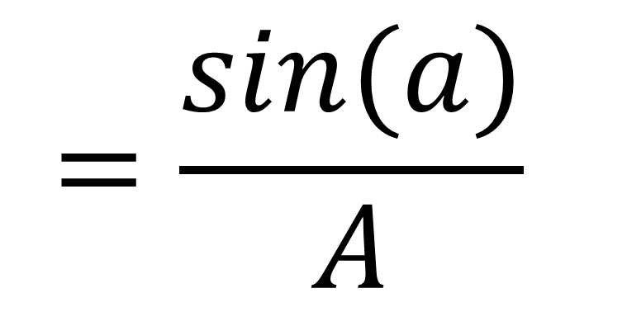
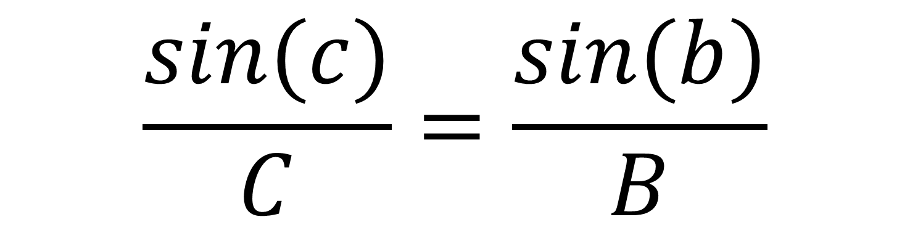
$$\frac{sin(c)}{C}=\frac{sin⁡(b)}{B}$$
$$=\frac{sin⁡(a)}{A}$$

Slide 4


$$h2=Csin(b)$$
$$h2=Bsin(c)$$

